Slide 1
Evaluation / Usability

Slide 2
ADDIE
Evaluate
Implement
Develop
Design
Analysis
Notes:
‹#›

Slide 3
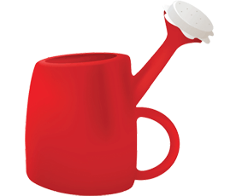
Usability
What is it?
Why do we need it?
How do we do it?

Slide 4
User-Centered Design Methods
Usability Testing
(Formative & Summative
Evaluation)
What does it mean
for something to
be usable?
Reporting
the results of
a usability test
Conducting an
evaluation
Understanding
users’ behaviors
Data collection
Notes:
‹#›

Slide 5
User-Centered Design
A philosophy of design from the field of Human Computer Interaction that asks...
“What is the experience like for the user?”
(Norman & Draper, 1986. User-centered system design)
Three characteristics of UCD:
early and continuing focus on users
empirical measurement (direct observation of actual users)
an iterative process of design, test, and redesign
(Gould & Lewis, 1985. Designing for usability: Key principles and what users think)
Notes:
‹#›

Slide 6
Types of evaluation
Usability Testing
Summative
Evaluation
Formative Evaluation
Project timeline: Analysis, Design… >>>
Final product
“how are we doing?”
goal is to improve the product
informs the design process
early and often
participants are authentic users
participants perform authentic tasks
observe and record what people say and do
analyze data, diagnose problems and make recommendations
“how did we do?”
validate the product
occurs after release
Notes:
‹#›

Slide 7
Formative and Summative evaluation strategies
Expert review – designated experts review the instruction.
One-to-one – evaluator observes one learner reviews the instruction.
Small group – evaluator observes 3-5 learners use material and debriefs them afterwards.
Field test – evaluator observes a final version implemented in realistic context with debriefings of learners afterwards.
(Tessmer, 1994. Formative evaluation alternatives)
Notes:
‹#›

Slide 8
Daily Life Usability Problems
Any example from real life?
Notes:
‹#›

Slide 9
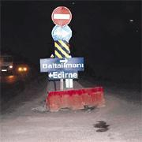
What does it mean to be usable?
26-11-2006
http://www.hurriyet.com.tr/gundem/5675530.asp?m=1&gid=112&srid=3430&oid=4
Notes:
‹#›

Slide 10
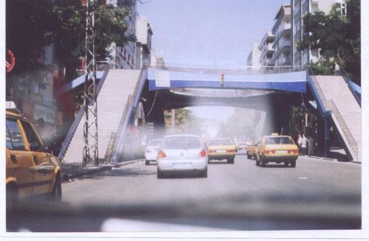
What does it mean to be usable?
Notes:
‹#›

Slide 11
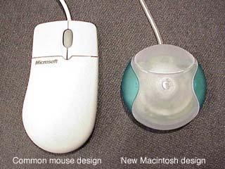
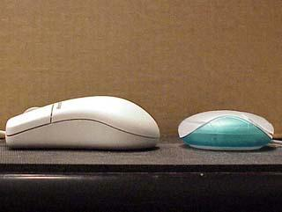
What does it mean to be usable?
Notes:
‹#›

Slide 12
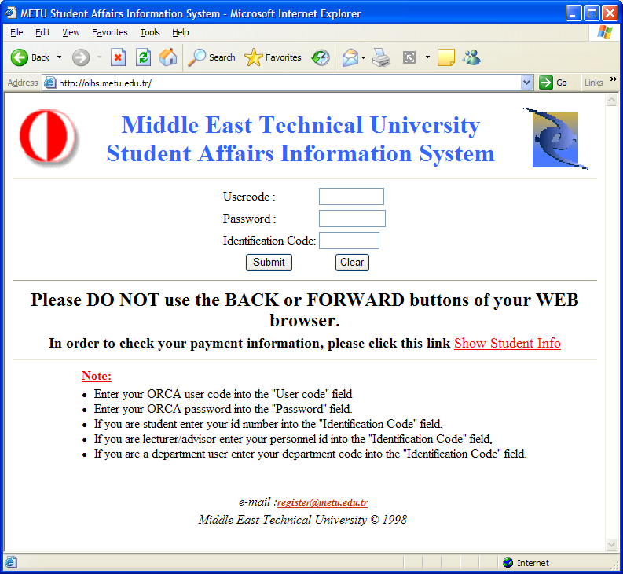
What does it mean to be usable? 1
Notes:
‹#›

Slide 13
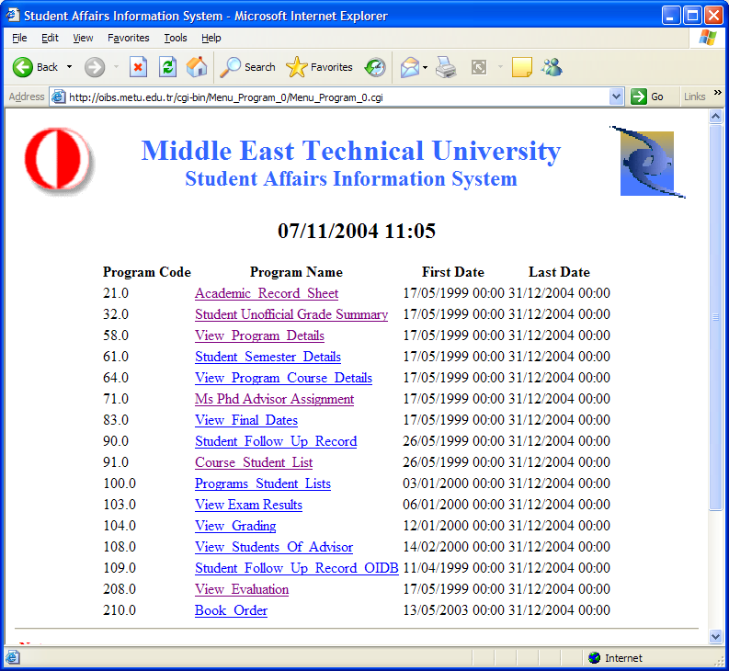
What does it mean to be usable? 2
Notes:
‹#›

Slide 14
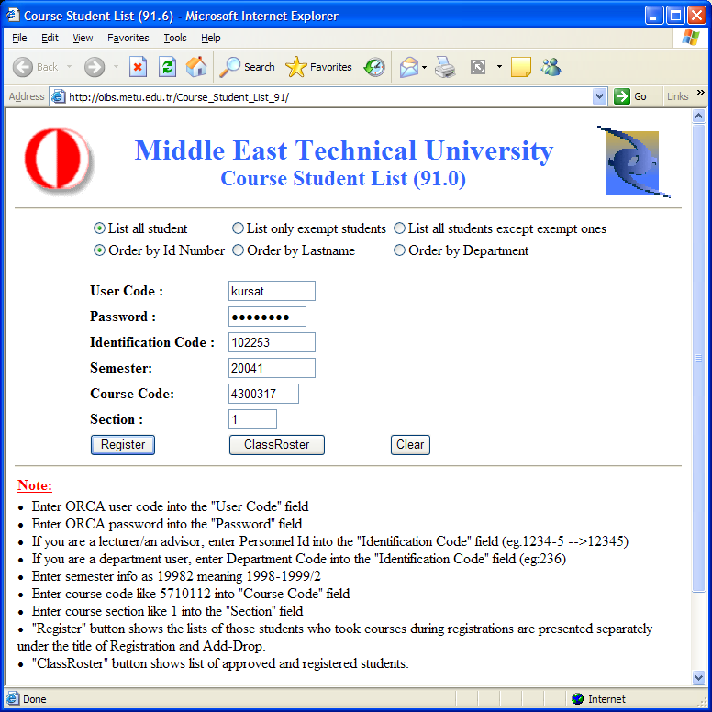
What does it mean to be usable? 3
Notes:
‹#›

Slide 15
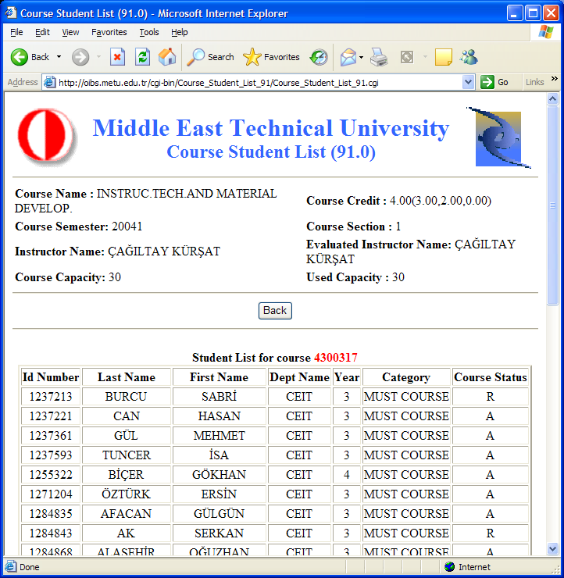
What does it mean to be usable? 4
Notes:
‹#›

Slide 16
What is usability?
Usability means focusing on users
People use products to be productive
Users are busy people trying to accomplish tasks
Users decide when a product is easy to use

Slide 17
Why Usability Testing?
To ensure that the product is usable for your user
Usability testing should be an iterative practice
Completed several times during the design and development life-cycle
End result is an improved product and a better understanding of the users that we’re designing for (Kaufmann 2006)

Slide 18
Usability Testing Components
Pilot Test
Usability Test
Notes:
‹#›

Slide 19
Usability Testing Components
Pilot testing
Designed to identify hidden issues and eliminate surprises.
Pilot testing tests the methods of your actual study as a trial
Not with actual users
During pilot testing you can make modifications to your final study
Notes:
‹#›

Slide 20
Usability Testing Components
Usability testing (Dumas & Reddish)
Goal to improve usability of a product
Participants represent real users
Participants do real tasks
You observe and record what participants do and day
You analyze the data, diagnose the real problems, and recommend changes to fix those problems
Notes:
‹#›

Slide 21
What does it mean to be usable?
Specified users will be able to achieve a specified goal in a specified environment in an effective, efficient, and a satisfying manner
(International Standards Organization)
Efficiency
Effectiveness
Satisfaction
Notes:
‹#›

Slide 22

Conducting your test: Things to consider…
How many users?
Length of test session?
Where to conduct the session?
Role of facilitator:
put participant(s) at ease (testing the material, not them)
observe and take notes
not to intervene or assist
Role, placement and responsibilities of other observers
Verbal protocol (“think-aloud”)
Token reward for participation (if appropriate)
Notes:
‹#›

Slide 23
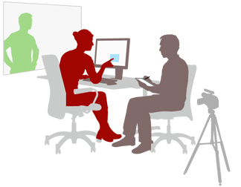
Understanding users’ behaviors
Effectiveness, efficiency, and satisfaction are not always correlated
Users tend to be more persistent in test settings
Users tend not to be critical (often blame themselves)
Notes:
‹#›

Slide 24
Data collection
Quantitative data (Statistical)
Number of errors made using/delivering the instruction
Time required for instructional activity(s)
Level of performance following the instruction
Questionnaire ratings of ease of learning, using, etc.
Qualitative data
Ease of use – are materials convenient, easy to locate, to use?
Learners’ reactions to materials, activities, evaluation
Was the environment appropriate for the instruction?
Notes:
‹#›

Slide 25
Analyzing & reporting your usability results
Quantitative data
descriptive data (number of users, time spent, errors)
be sure and discuss any data tables (what do they mean?)
Qualitative data
consolidate your observations (negatives and positives!)
extract common themes
identify critical themes (e.g. length of time required)
perform member checking if possible
determine solutions for addressing the problems
summarize and present your findings and solutions
Notes:
‹#›

Slide 26
Protocol
Introduction
Thank you...for agreeing to participate in this session.
Product Description...An educational software to teach Physics.
Purpose of session...is to make this product better.
This product may have problems.
Any problems you have or find with the product is with the product, not your fault.
Instructions...
I'll be asking you do certain things with the program and watching and writing notes as you do them. That's just to help me remember how things went later on.
To help me do this, I'd like you to "think out loud" as you use the program and make your decisions to do certain things.
I'd like you to try and perform the given tasks on your own as best you can. If you’re really stuck, I may be able to help, but I’d really like you to try it without my help.
At any time, you can quit a particular task and move on or you may choose to quit the entire session.
Notes:
‹#›

Slide 27
Observation sheet
Efficiency
 | Start time: |  |  |  | Finish time:
page/link name |  |  | Notes |  |  |  | +/-
name of starting page
Efficiency
Effectiveness
Notes:
‹#›

Slide 28
Analyzing & reporting your usability results
Observations
Interpretation
Recommendation
Notes:
‹#›

Slide 29
User-Centered Design Methods
Usability Testing
(~ Formative Evaluation)
What does it mean
for something to
be usable?
Reporting
the results of
a usability test
Conducting an
evaluation
Understanding
users’ behaviors
Data collection
Notes:
‹#›

Slide 30
Any Question(s)
Thanks

